Slide 1

Exception Handling
Handling Errors During the Program Execution
SoftUni Team
Technical Trainers
Software University
https://softuni.bg

Slide 2
Table of Contents
What Are Exceptions?
The Exception Class
Types of Exceptions and Their Hierarchy
Handling Exceptions
Raising (Throwing) Exceptions
Best Practices
Creating Custom Exceptions

Slide 3
Have a Question?
sli.do
#java-advanced

Slide 4

What Are Exceptions?

Slide 5
What Are Exceptions?
Simplify code construction and maintenance
Allow the problematic situations to be processed at multiple levels
Exception objects have detailed information about the error
There are two ways to write error-free programs; only the third one works. (Alan J. Perlis)
5

Slide 6
The Throwable Class
Exceptions in Java are objects
The Throwable class is a base for all exceptions in JVM
Contains information for the cause of the error
Message – a text description of the exception
StackTrace – the snapshot of the stack at the moment of exception throwing
6

Slide 7
Types of Exceptions
Java exceptions inherit from Throwable
Below Throwable are:
Error - not expected to be caught under normal circumstances from the program
Example - StackOverflowError
Exception
Used for exceptional conditions that user programs should catch
User-defined exceptions

Slide 8
Exceptions
Exceptions are two types:
Checked - an exception that is checked (notified) by the compiler at compilation-time
Also called as Compile Time exceptions
Unchecked - an exception that occurs at the time of execution
Also called as Runtime Exceptions
public static void main(String args[]) {
File file = new File("E://file.txt");
FileReader fr = new FileReader(file);
}
FileNotFoundException

Slide 9
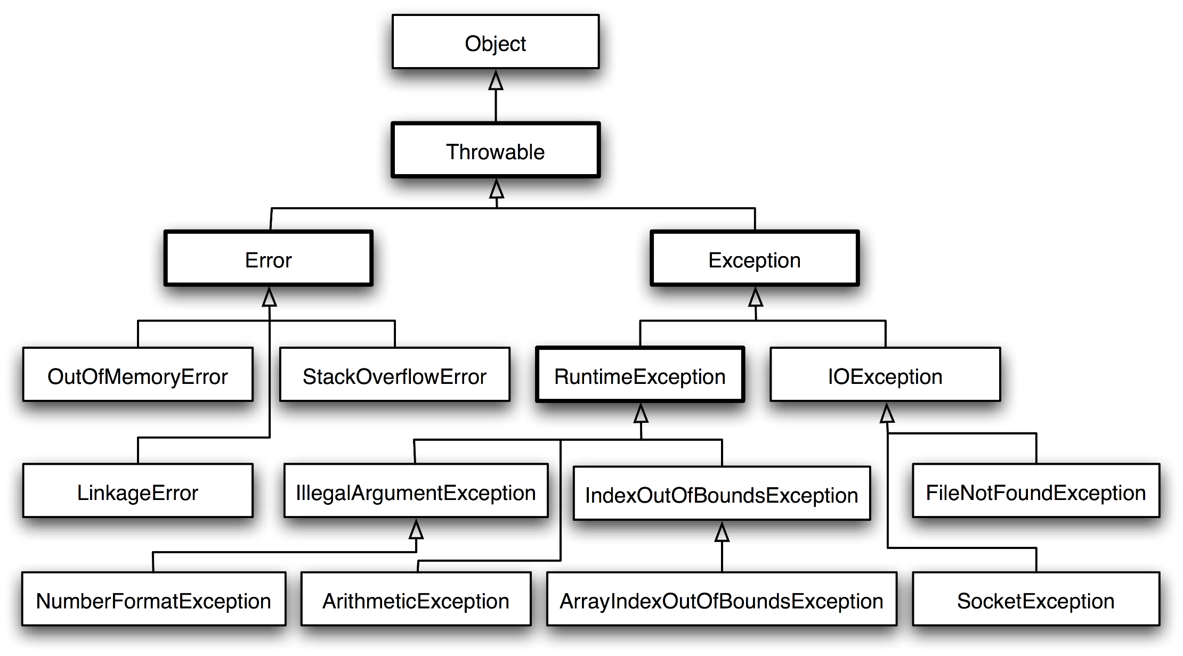
Exception Hierarchy
9

Slide 10

Handling Exceptions

Slide 11

Handling Exceptions
In Java exceptions can be handled by the try-catch construction
catch blocks can be used multiple times to process different exception types
try {
// Do some work that can raise an exception
} catch (SomeException) {
// Handle the caught exception
}
11

Slide 12
Multiple Catch Blocks – Example
String s = sc.nextLine();
try {
Integer.parseInt(s);
System.out.printf(
"You entered a valid integer number %s.", s);
} catch (NumberFormatException ex) {
System.out.println("Invalid integer number!");
}
12

Slide 13

Handling Exceptions
When catching an exception of a particular class, all its inheritors (child exceptions) are caught too, e.g.
Handles IndexOutOfBoundsException and its descendants ArrayIndexOutOfBoundsException and StringIndexOutOfBoundsException
try {
// Do some work that can cause an exception
} catch (IndexOutOfBoundsException ae) {
// Handle the caught arithmetic exception
}

Slide 14
Find the Mistake!
String str = sc.nextLine();
try {
Integer.parseInt(str);
} catch (Exception ex) {
System.out.println("Cannot parse the number!");
} catch (NumberFormatException ex) {
System.out.println("Invalid integer number!");
}
Should be last
Unreachable code

Slide 15
Handling All Exceptions
Unmanaged code can throw other exceptions
For handling all exceptions (even unmanaged) use the construction:
try {
// Do some work that can raise any exception
} catch (Exception ex) {
// Handle the caught exception
}

Slide 16
The Try-finally Statement
The statement:
Ensures execution of a given block in all cases
When exception is raised or not in the try block
Used for execution of cleaning-up code, e.g. releasing resources
try {
// Do some work that can cause an exception
} finally {
// This block will always execute
}

Slide 17
Try-finally – Example
static void testTryFinally() {
System.out.println("Code executed before try-finally.");
try {
String str = sc.nextLine();
Integer.parseInt(str);
System.out.println("Parsing was successful.");
return; // Exit from the current method
} catch (NumberFormatException ex) {
System.out.println("Parsing failed!");
} finally {
System.out.println("This cleanup code is always executed.");
}
System.out.println("This code is after the try-finally block.");
}

Slide 18
How Do Exceptions Work?
try
Run this code
catch
Execute this code when there is an exception
finally
Always run this code

Slide 19

Handling Exceptions

Slide 20

Throwing Exceptions

Slide 21
Throwing Exceptions
Exceptions are thrown (raised) by the throw keyword
Used to notify the calling code in case of an error or unusual situation
When an exception is thrown:
The program execution stops
The exception travels over the stack
Until a matching catch block is reached to handle it
Unhandled exceptions display an error message

Slide 22
Using Throw Keyword
Throwing an exception with an error message:
Exceptions can accept message and cause:
Note: if the original exception is not passed, the initial cause of the exception is lost
throw new IllegalArgumentException("Invalid amount!");
try {
…
} catch (SQLException sqlEx) {
throw new IllegalStateException("Cannot save invoice.", sqlEx);
}

Slide 23
Re-Throwing Exceptions
Caught exceptions can be re-thrown again:
try {
Integer.parseInt(str);
} catch (NumberFormatException ex) {
System.out.println("Parse failed!");
throw ex; // Re-throw the caught exception
}

Slide 24
Throwing Exceptions – Example
public static double sqrt(double value) {
if (value < 0)
throw new IllegalArgumentException(
"Sqrt for negative numbers is undefined!");
return Math.sqrt(value);
}
public static void main(String[] args) {
try {
sqrt(-1);
} catch (IllegalArgumentException ex) {
System.err.println("Error: " + ex.getMessage());
ex.printStackTrace();
}
}

Slide 25

Throwing Exceptions

Slide 26

Best Practices

Slide 27
Using Catch Block
Catch blocks should:
Begin with the exceptions lowest in the hierarchy
Continue with the more general exceptions
Otherwise a compilation error will occur
Each catch block should handle only these exceptions which it expects
If a method is not competent to handle an exception, it should leave it unhandled
Handling all exceptions disregarding their type is a popular bad practice (anti-pattern)!

Slide 28
Choosing the Exception Type (1)
When an application attempts to use null in a case where an object is required – NullPointerException
An array has been accessed with an illegal index – ArrayIndexOutOfBoundsException
An index is either negative or greater than the size of the string – StringIndexOutOfBoundsException
Attempts to convert a inappropriate string to one of the numeric types - NumberFormatException

Slide 29
Choosing the Exception Type (2)
When an exceptional arithmetic condition has occurred – ArithmeticException
Attempts to cast an object to a subclass of which it is not an instance – ClassCastException
A method has been passed an illegal or inappropriate argument - IllegalArgumentException

Slide 30


Exceptions – Best Practices (1)
When raising an exception, always pass to the constructor a good explanation message
When throwing an exception always pass a good description of the problem
The exception message should explain what causes the problem and how to solve it
Good: "Size should be integer in range [1…15]"
Good: "Invalid state. First call Initialize()"
Bad: "Unexpected error"
Bad: "Invalid argument"

Slide 31
Exceptions – Best Practices (2)
Exceptions can decrease the application performance
Throw exceptions only in situations which are really exceptional and should be handled
Do not throw exceptions in the normal program control flow
JVM could throw exceptions at any time with no way to predict them
E.g. StackOverflowError

Slide 32

Custom Exceptions

Slide 33
Creating Custom Exceptions
Custom exceptions inherit an exception class (commonly – Exception)
Thrown just like any other exception
public class TankException extends Exception {
public TankException(String msg) {
super(msg);
}
}
throw new TankException("Not enough fuel to travel");

Slide 34

Summary
…
…
…
Exceptions provide a flexible error handling mechanism
Unhandled exceptions cause error messages
try-finally ensures a given code block is always executed
Even when an exception is thrown

Slide 35
Questions?
Notes:
35

Slide 36











SoftUni Diamond Partners

Slide 37



Educational Partners

Slide 38
Trainings @ Software University (SoftUni)
Software University – High-Quality Education, Profession and Job for Software Developers
softuni.bg
Software University Foundation
softuni.foundation
Software University @ Facebook
facebook.com/SoftwareUniversity
Software University Forums
forum.softuni.bg
38
Notes:
38

Slide 39

License
This course (slides, examples, demos, exercises, homework, documents, videos and other assets) is copyrighted content
Unauthorized copy, reproduction or use is illegal
© SoftUni – https://about.softuni.bg
© Software University – https://softuni.bg
Notes:
39

